Slide 1
Automotive Wiring

Slide 2

Agenda
01
DC Basics
02
Circuit Diagrams
03
Power/Ground
04
Terminals: KL15 and KL30

Slide 3

01 – DC Basics

Slide 4
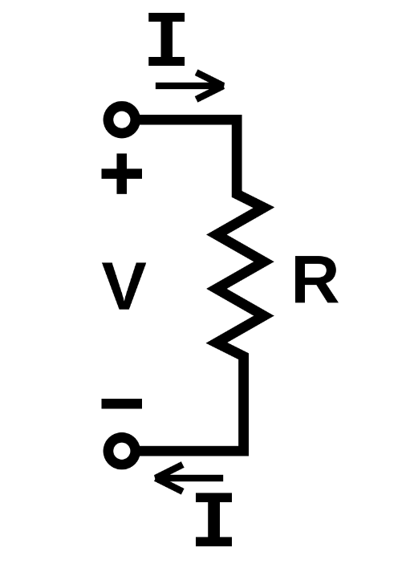
DC Basics
Ohm’s Law Diagram
Overview
Definition: Direct Current (DC) is a type of current that flows in one direction
Importance: Understanding DC is essential to understanding circuit diagrams
Current – The flow rate of electric charge in a circuit
Voltage – The potential difference between 2 points in a circuit
Resistance – The opposition to current flow
Ohm’s Law – V = IR
Notes:
Can relate current to water flow as an analogy
Current – flow of water, how much water is flowing per unit time
Voltage – the pressure of the water, higher voltage is like higher pressure
Resistance – narrowness of the pipe that the water is flowing through. The narrower the pipe, the higher the resistance, preventing from the water from flowing as fast
How they relate to one another
If you have high pressure (high voltage) and a very wide pipe (low resistance), the current will be high
If you make the pipe more narrow (increase resistance) current will decrease
By rearranging the formula to I = V/R, it might be easier to visualize the relationship between the three. This shows us that voltage and current proportional to one another but current and resistance are inversely proportional

Slide 5
02 – Circuit Diagrams

Slide 6
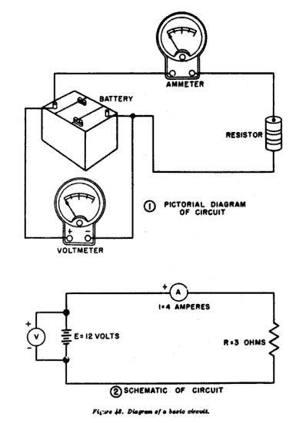
Circuit Diagrams
Sample Circuit Diagrams
Overview
Definition: A Circuit Diagram is a graphical representation of an electrical circuit using standardized symbols
Importance: Circuit Diagrams help visualize and understand Automotive Systems, allowing you to analyze, troubleshoot, and modify systems
Components – Resistors, relays, switches, etc. that are represented by standardized symbols
Wires – Represented by lines that connect components together in a circuit
Power Source – Batteries, generators, etc.

Slide 7
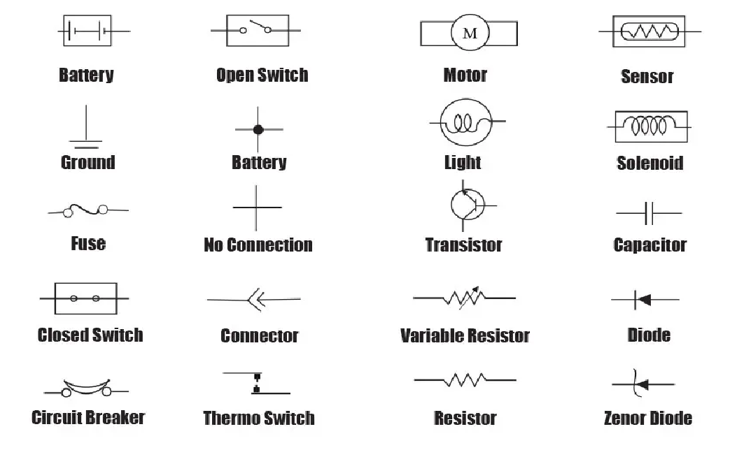
Symbols
Connected
Notes:
Battery: Stores and supplies electrical energy, like a AA battery or car battery.
Open Switch: Interrupts the flow of current in a circuit, like a light switch in the "off" position.
Motor: Converts electrical energy into mechanical motion, like the motor that spins a fan.
Sensor: Detects physical or environmental changes and converts them into electrical signals, like a temperature sensor.
Ground: A reference point from which voltages in a circuit are measured
Connected: Two components are electrically joined, allowing current to flow between them.
Light: An electrical device that produces visible light, like an LED or incandescent bulb.
Solenoid: An electromagnet that converts electrical energy into a pulling or pushing force, often used to activate switches or valves.
Fuse: A safety device that melts or breaks if too much current flows through it, protecting the circuit from damage.
No connection: Two components are not electrically joined and current cannot flow between them.
Transistor: A semiconductor device that can amplify or switch electronic signals.
Capacitor: Stores electrical energy in an electric field, often used for temporary power storage or signal filtering.
Closed Switch: Completes the circuit and allows current to flow, like a light switch in the "on" position.
Connector: Provides a physical and electrical connection between components, like a plug and socket.
Variable Resistor: A resistor with adjustable resistance, allowing control over current flow, like a volume knob.
Diode: Allows current to flow in one direction only, like a one-way valve for electricity.
Circuit Breaker: A reusable safety device that automatically interrupts current flow if it exceeds a certain level.
Thermo Switch: A switch that turns on or off based on temperature changes
Resistor: Opposes the flow of current in a circuit, limiting current and controlling voltage, like a dimmer switch for LEDs.
Zener Diode: A special type of diode that allows current to flow in the reverse direction when a certain voltage is reached, used for voltage regulation.

Slide 8
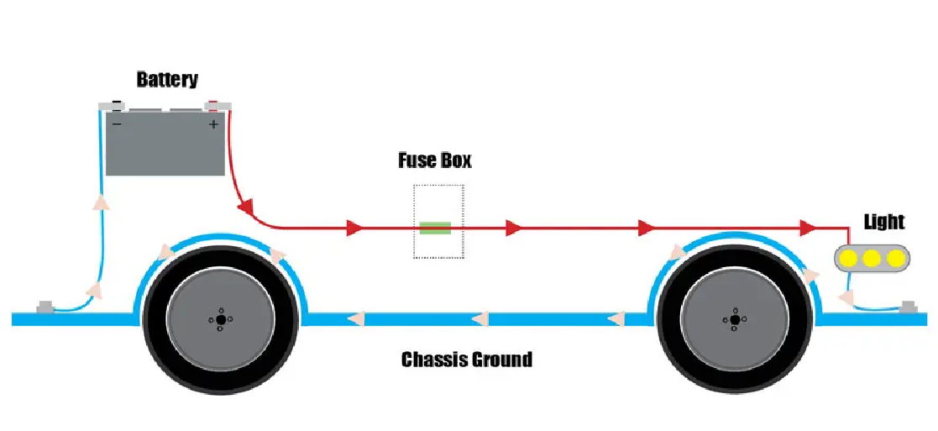
Simple Circuit

Slide 9
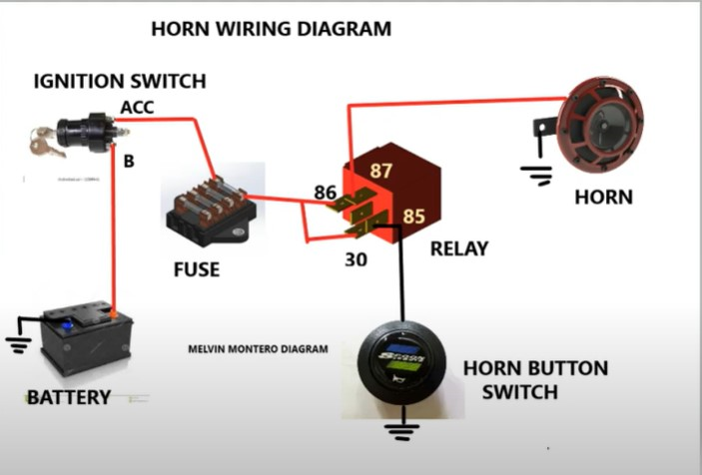
Horn Wiring Diagram

Slide 10
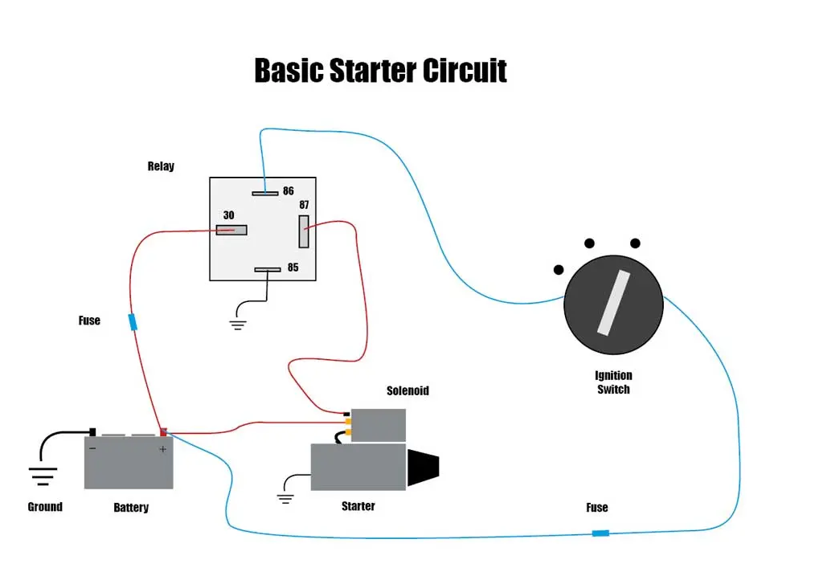
Basic Starter Circuit

Slide 11
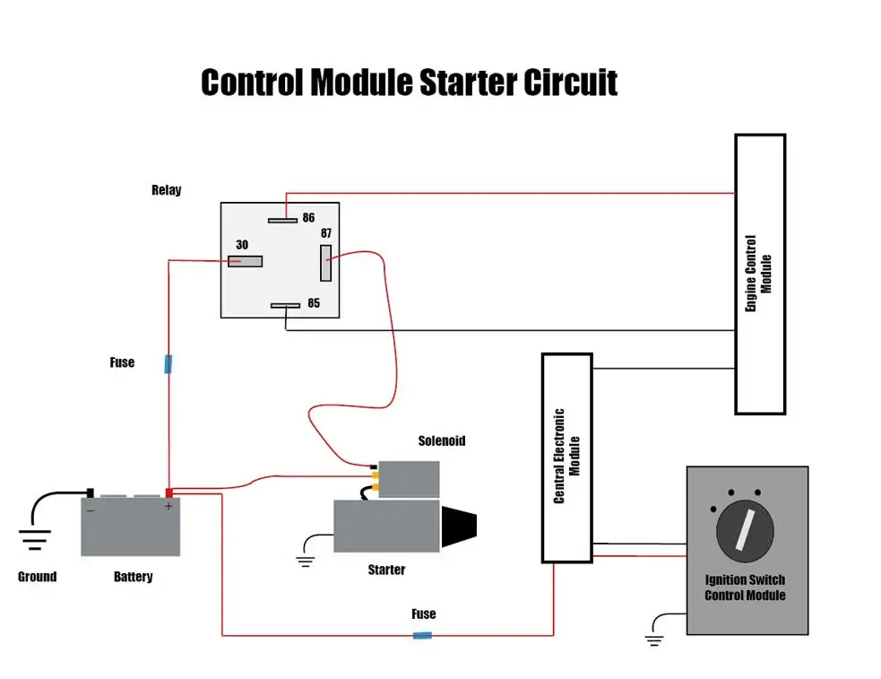
Control Module Starter Circuit

Slide 12
03 – Power and Ground

Slide 13

Power and Ground
Symbol for Ground
Overview
Definition: Power and Ground is the discussion of power supply to circuits and the importance of grounding
Importance: Grounding is an important safety feature in a circuit, while power is essential for a system to operate
Power – The electrical energy available in a system, measured in Volts
Ground – The reference point in a circuit from which voltages are measured, also allows for safe discharge in case of malfunctions
Notes:
Note that from a physics perspective, Power is measured in energy/unit time or voltage * current. In our context, we are talking about the potential of power, so voltage alone is sufficient.

Slide 14
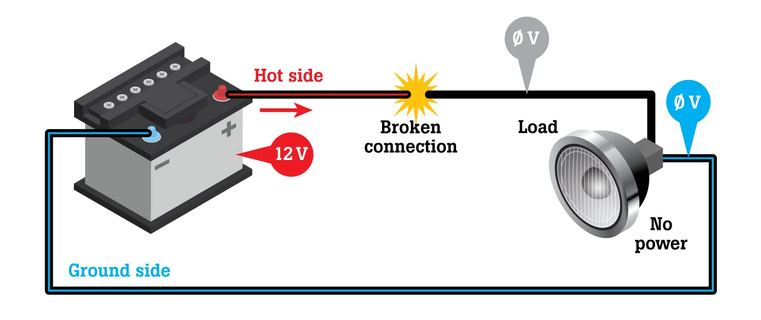
Power and Ground

Slide 15
04 – Terminals: KL-15 and KL-30

Slide 16

Terminals: KL15 and KL30
Overview
Overview
Definition: KL15 and KL30 indicate where and when power is received for different automotive systems
Importance: Understanding KL15 and KL30 can help understand automotive systems better and ease the diagnosis process
KL15 – ignition-powered – only powered when ignition is turned on
KL30 – battery-powered – powered independent of ignition state, continuous
KL31 – ground
Notes:
‘KL’ is the abbreviation for ‘klemme’ which is the German term for connector/connection, or ‘Klemmenbezeichnungen’. Klemmenbezeichnungen means Terminal designations.
https://www.spoolstreet.com/threads/bmw-battery-terminals-explanation-15-15n-15wup-30-30g-30g_f-30b-30f-50.5630/

Slide 17

KL15
KL15 Plug
Overview
Definition: KL15 terminal is ignition-powered
Importance: KL15 powers systems that should run when ignition is turned on
Features powered by KL15:
Dashboard Displays
Interior Lighting
KL15N – used for systems operating while the vehicle is being driven
Notes:
Refers to the ignition-controlled power. This means that this circuit or power source is active when the ignition key is in the "ON" position. It provides power to components that need to be active only when the vehicle is either running or in the accessory position, such as the car radio, engine control unit, or air conditioning.

Slide 18

KL30
KL30 Plugs
Overview
Definition: KL30 terminal is battery-powered
Importance: Certain systems in a car must be running regardless of ignition
Features powered by KL30:
Security
Memory/Clock
ECU
KL30B (originally KL30G) – constant power
KL30F – cuts power when fault encountered
Notes:
Represents the direct connection to the battery, meaning it provides constant power regardless of the ignition key position. This is the source for all components that need power even when the vehicle is turned off, like security systems, clock, or certain memory functions in modules.

Slide 19

Battery
Notes:
Here, walk through an example of building a circuit. Start with the battery, which is a power source for many of the car’s systems .

Slide 20
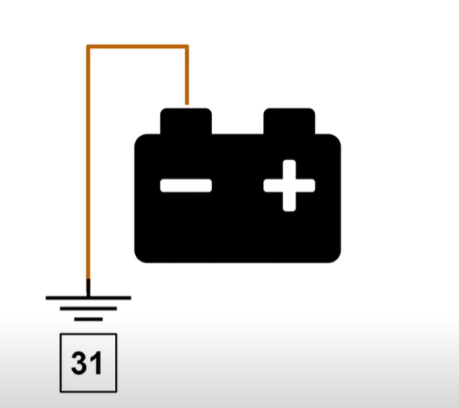
Terminal 31
Notes:
Terminal 31 is ground. As we learned before, ground is a reference point to measure voltages and also a viable path for the current to take in cases of overcurrent.

Slide 21
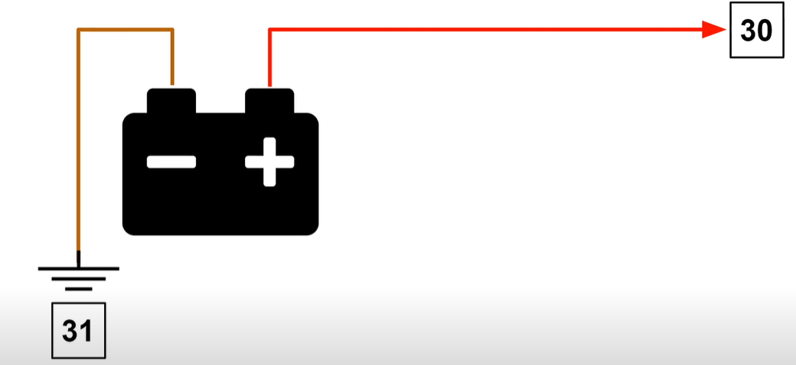
Terminal 31
Notes:
We also know that terminal 30 is connected right to the battery, as it helps power systems that should be running all the time, not just when the ignition is turned on

Slide 22
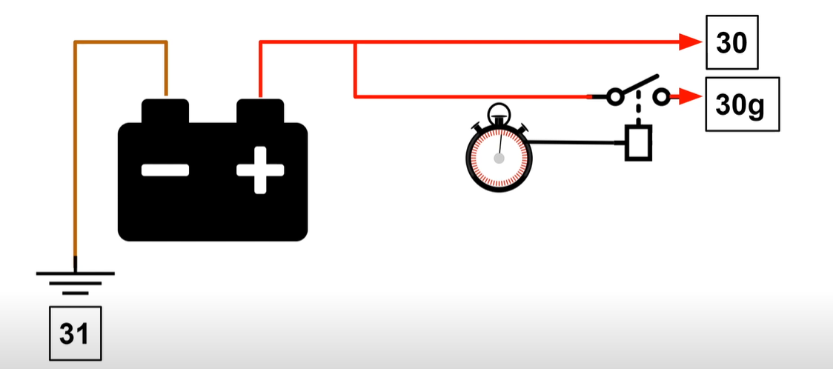
Terminal 30B (Previously named: 30g)
Notes:
Terminal 30B provides continuous power to essential systems of the car

Slide 23
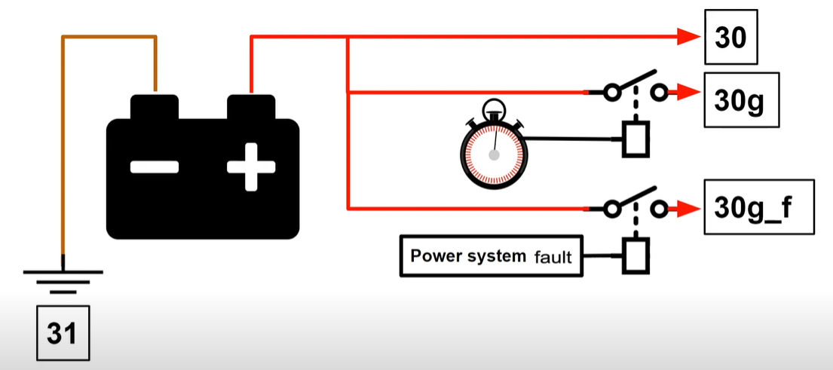
Terminal 30F (Previously named: 30g_f)
Notes:
30F is similar but it switches off in the event of a fault, thus mitigating damage to the components

Slide 24
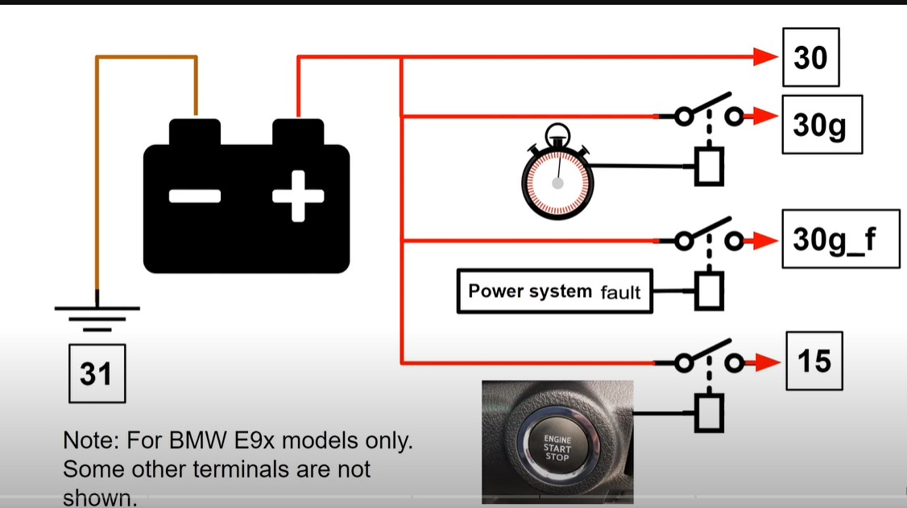
Terminal 15 & 15 N
Notes:
Finally, we add 15, which supplies power to certain systems when the ignition is switched on
15N powers systems that are necessary when the vehicle is actually being driven

Slide 25
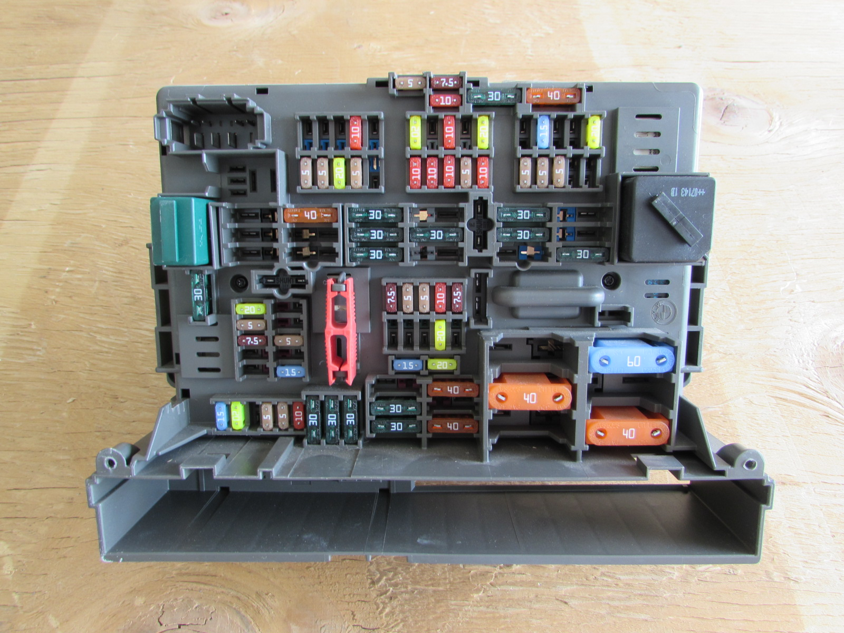
BMW Fuse Box
Notes:
Here, we see an example of a fuse box

